Slide 1
DR In Enterprise Architecture – Part 1
DR considerations:
DR plan
RTO & RPO

Slide 2
DR In Enterprise Architecture – Part 1
DR plan:
A disaster recovery policy statement, plan overview and main goals of the plan
Key personnel and DR team contact information
http://searchdisasterrecovery.techtarget.com/definition/disaster-recovery

Slide 3
DR In Enterprise Architecture – Part 1
DR plan (contd)…:
Description of emergency response actions immediately following an incident.
A diagram of the entire network and recovery site.
Directions for how to reach the recovery site.
http://searchdisasterrecovery.techtarget.com/definition/disaster-recovery

Slide 4
DR In Enterprise Architecture – Part 1
DR plan (contd)…:
A list of software and systems that will be used in the recovery.
Sample templates for a variety of technology recoveries, including technical documentation from vendors.
http://searchdisasterrecovery.techtarget.com/definition/disaster-recovery

Slide 5
DR In Enterprise Architecture – Part 1
DR plan (contd)…:
Summary of insurance coverage.
Proposed actions for dealing with financial and legal issues.
Ready-to-use forms to help complete the plan.

Slide 6
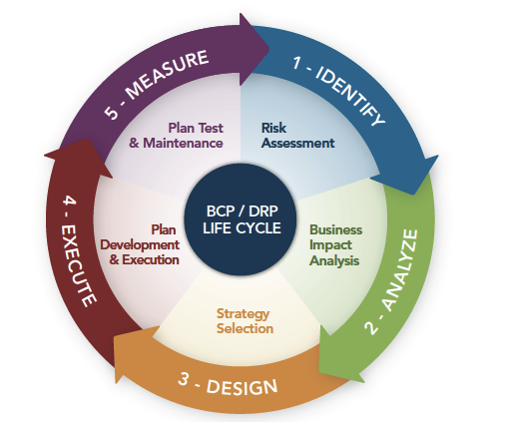
DR In Enterprise Architecture – Part 1
http://grcbizassurance.com/services/disaster-recovery/

Slide 7
DR In Enterprise Architecture – Part 1
RTO:
Max amount of time, following a disaster, for an org to recover files from backup storage and resume normal operations; max amount of downtime an org can handle.
http://searchdisasterrecovery.techtarget.com/definition/disaster-recovery

Slide 8
DR In Enterprise Architecture – Part 1
RTO:
If an organization has an RTO of two hours, it cannot be down for longer than that
http://searchdisasterrecovery.techtarget.com/definition/disaster-recovery

Slide 9
DR In Enterprise Architecture – Part 1
RPO:
RPO is the max age of files that an organization must recover from backup storage for normal operations to resume after a disaster; determines the minimum frequency of backups.
http://searchdisasterrecovery.techtarget.com/definition/disaster-recovery

Slide 10
DR In Enterprise Architecture – Part 1
RPO:
For example, if an organization has an RPO of four hours, the system must back up at least every four hours
http://searchdisasterrecovery.techtarget.com/definition/disaster-recovery

